Slide 1
Final Defense Reducing the Mismatch between Global and Detailed Routing
Daohang Shi
Advised by Professor Azadeh Davoodi
Notes:
// don’t move the laser point around

Slide 2
Outline
Introduction and preliminaries
Overview of global routing (GR) and detailed routing (DR)
Sources of mismatch between GR and DR
Summary of contributions
Via-aware track planning for global routing
Notes:
We will first talk about introduction and preliminaries, including ….
After that, we will go thru the summary of the proposal.
The project I have done is called via aware GR, which includes works on modeling and algorithm.
In the end, I will introduce three future works.

Slide 3
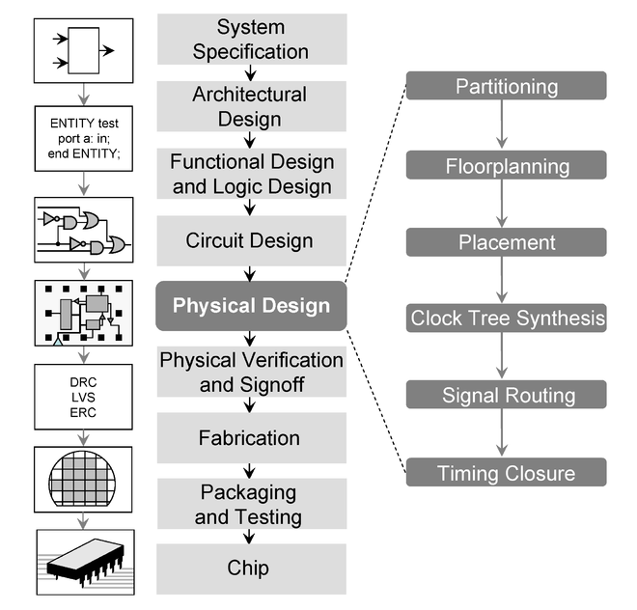
Introduction and Preliminaries
Global and detailed routing are key steps in the VLSI design flow
Global Routing
Detailed Routing
Notes:
This is the design flow of VLSI.
In physical design, there are several steps.
Signal routing is an important and time-consuming step in design cycle.
Particularly in signal routing, we first do global routing and then perform a much more time consuming detailed routing.
This work is going to focus on reducing the mismatch between them, as I will explain it later, which makes the flow much more efficient.

Slide 4
Introduction and Preliminaries
Relationship between GR and DR
Global Routing
Partitions the routing region into g-cells
Constructs a grid graph
G-cell → vertex
Boundary between two g-cells → edge
Finds routing trees on the grid graph
Detailed Routing
Uses global routing solution as the starting point
Determines the exact wirings for each net
Assigns every routing wire to a specific routing track
Determines the exact locations of vias to connect adjacent layers
Pins, rather than g-cells, are connected
Boundary
Edge
Assign to routing tracks
Net pins
Via
Notes:
In this slide, I'm going to give a brief introduction to global routing and detailed routing before discussing the mismatch between them.
For example, there is a net with 2 net pins in this figure. (CLICKx2)
In global routing, the routing region is first partitioned into several small tiles ( we called them global cells or g-cells ). (CLICKx2)
Then we construct a grid graph based on the partitioning.
Each g-cell becomes a vertex (CLICK)
Every boundary between two adjacent g-cells becomes an edge (CLICKx5)
In the grid graph, we are going to find a route to connect the two vertices containing the two net pins. (CLICK)
In this case, the route to connect them is L-shape.(CLICK)
After GR, we use the GR solution as the starting point and then perform a DR to determine the exact physical information of the detailed routes.
(CLICK)
We need to assign every global route to a specific routing track, as shown in the figure.
We also need to determine the exact locations of vias to connect adjacent metal layers.
When DR finishes, net pins, instead of g-cells, are connected with detailed wirings.
//GR is an approximation because it’s using a coarse-grained grid

Slide 5
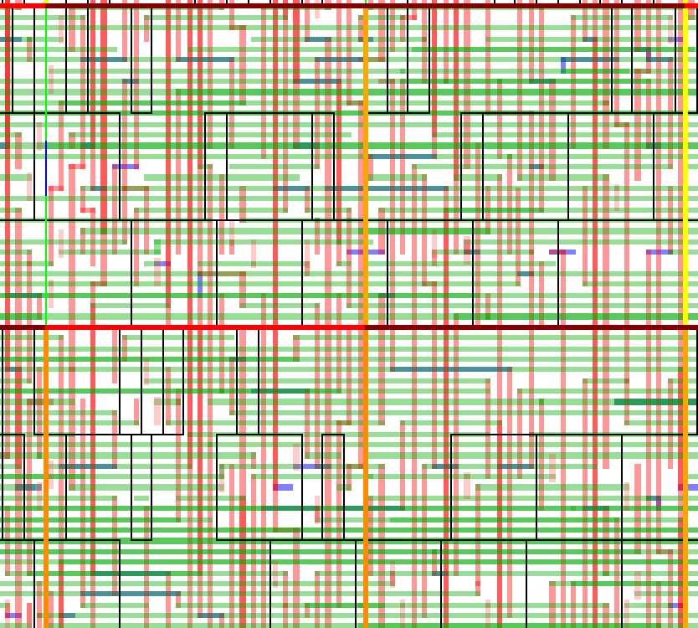
Introduction and Preliminaries
Track assignment
Transition to detailed routing solution from global routing
Each flat segment is assigned to track by following GR
Followed by DR which modify track assignment to satisfy design rules
…
…
…
Panel (consisting of g-cells)
Global segments of net 2
G-cells
Global segments of net 3
Global segment of net 1
…
…
…

Slide 6
Introduction and Preliminaries
Mismatch between GR and DR
In advanced technology nodes, increasingly, there are design rules which have to be considered during DR but are ignored during GR
Mismatch also exists because of how GR approximates DR
The mismatch reduces the utility of global routing as an effective starting point for DR and results in significant increase in runtime of DR to resolve violations
Sources of mismatch between GR and DR
Local nets
Inter-layer vias
Pin access problem
Other manufacturing issues
Metrics for routability evaluation
Notes:
Now I am going to discuss the mismatch between GR and DR.
The background is that, in advanced tech nodes, there are many design rules which have to be considered by detailed router but are usually ignored during GR.
These design rules cause the mismatch between GR and DR, which reduces the utility of GR as an effective starting point for DR and makes it more difficult and more time consuming for detailed router to resolve all the DRC violations caused by those additional design rules.
The sources of mismatch between GR and DR are mainly categorized as follows.
And I'm going to introduce them one by one.

Slide 7
Introduction and Preliminaries
Local nets
All the pins of a local net are within the same g-cell
Local nets are traditionally ignored in GR but they are becoming a considerable percentage of total number of nets [1]
Few research works consider local nets during GR [2-3] but accuracy of the local net model has not been verified
Sources of mismatch between GR and DR
N. Viswanathan et al. “The ISPD-2011 routability-driven placement contest and benchmark suite”, ISPD, 2011.
H. Shojaei et al. “Planning for local net congestion in global routing”, ISPD, 2013.
Y. Wei et al. “GLARE: global and local wiring aware routability evaluation”, DAC, 2012.
Notes:
The first mismatch I’m going to introduce is local nets
Local nets are those nets with all net pins located in the same g-cell.
Local nets are traditionally ignored in GR but they take a considerable portion of all the nets.
For example, they may take around 30% of all the nets in ISPD2011 benchmarks for some version of placements.
There is a few research work considering the local nets in global routing
However the accuracy of the study of local nets has not been verified by detailed router yet.

Slide 8
Introduction and Preliminaries
Sources of mismatch between GR and DR
Models of inter-layer vias [1-4]
A via connects wires on adjacent metal layers to each others
Via size depends on the sizes of the wires that are connected by it
A via may block extra routing tracks on the layer with smaller wire size
Via size is not typically modeled during GR
X. Jia et al. “MCFRoute: a detailed router based on multi-commodity flow method”, ICCAD, 2014.
K. Han et al. “Evaluation of BEOL design rule impacts using an optimal ILP-based detailed router”, DAC, 2015.
Y. Zhang et al. “RegularRoute: an efficient detailed router with regular routing patterns”, ISPD, 2011.
C. Hsu et al. “Multi-layer global routing considering via and wire capacities”, ICCAD, 2008.
Notes:
Another mismatch I'm going to discuss is about via restrictions and spacing issues.
First lets talk about via restriction.
For example, in this metal layer, there are two routes with different kinds of via connection.
These two are vias. They are used to connect two adjacent metal layers to each other.
One route is connected to the lower metal layer thru a via.
The via size is the same with the wire size on that metal layer.
The other route is connected to the higher metal layer thru a larger via.
This via is larger than the other one because the higher metal layer has a greater wire size.
So a larger via is required to connect two adjacent metal layers of different wire sizes.
Compared to the other one, the large via may cause more blockage, which has never been considered before in any other work.
However, such issue is becoming more common, especially in advanced tech nodes.
For example, metal layers with four different wire sizes are used in 32 nm.
The wire sizes in two adjacent metal layers can differ up to 2x.
Second, let's talk about spacing issues.
Certain types of nets may require more spacing with wire segments of adjacent nets, especially on timing-critical paths.

Slide 9
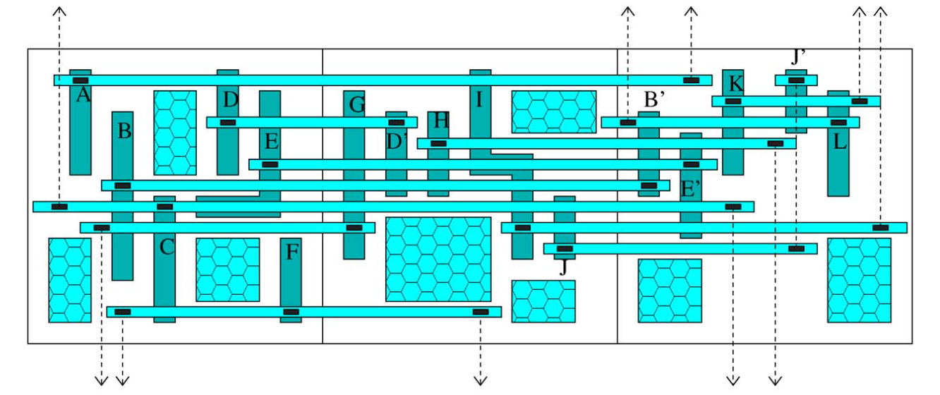
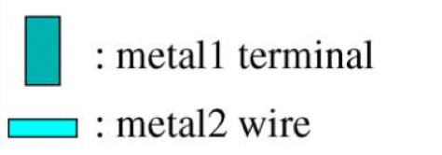
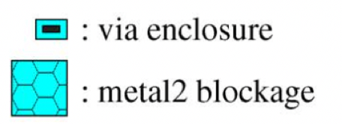
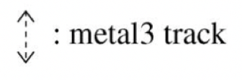
Introduction and Preliminaries
Sources of mismatch between GR and DR
Lack of pin access model in GR
During DR, connection to each pin is through one or more of its “tapping points”
Lack of pin access model in GR becomes a more challenging issue in advanced technology nodes because:
There are fewer tapping points for each pin
Various blockage limit access to the tapping points
Figure from [3]
Mentor Graphics White Paper. “Understanding physical design constraints in the 10nm era”. http://go.mentor.com/4O2zY
Cadence Design Systems. “LEF DEF exchange format versions 5.7 reference documentation plus reader”. https://www.si2.org/openeda.si2.org/projects/lefdefnew/
M. Ozdal, “Detailed-routing algorithms for dense pin clusters in Integrated Circuits”, TCAD, 2009.
Notes:
Another mismatch I'm going to discuss is about via restrictions and spacing issues.
First lets talk about via restriction.
For example, in this metal layer, there are two routes with different kinds of via connection.
These two are vias. They are used to connect two adjacent metal layers to each other.
One route is connected to the lower metal layer thru a via.
The via size is the same with the wire size on that metal layer.
The other route is connected to the higher metal layer thru a larger via.
This via is larger than the other one because the higher metal layer has a greater wire size.
So a larger via is required to connect two adjacent metal layers of different wire sizes.
Compared to the other one, the large via may cause more blockage, which has never been considered before in any other work.
However, such issue is becoming more common, especially in advanced tech nodes.
For example, metal layers with four different wire sizes are used in 32 nm.
The wire sizes in two adjacent metal layers can differ up to 2x.
Second, let's talk about spacing issues.
Certain types of nets may require more spacing with wire segments of adjacent nets, especially on timing-critical paths.

Slide 10
Introduction and Preliminaries
Sources of mismatch between GR and DR
Manufacturing rules ignored during GR including:
Spacing rules: require the minimum distance between routes
Min-area rules [1-2]: require minimum area for every polygon-shape
Metrics for routability evaluation
During GR, traditional overflow metrics increasingly fail to give a clear prediction of routability at the DR stage
New metrics are proposed for GR but not evaluated at DR [3-4]
X. Jia et al. “A detailed router based on multi-commodity flow method”, ICCAD, 2014.
X. Xu et al. “PARR: pin access planning and regular routing for self-aligned double patterning”, DAC, 2015.
W. Liu et al. “Routing congestion estimation with real design constraints”, DAC, 2013.
Y. Wei et al. “GLARE: global and local wiring aware routability evaluation”, DAC, 2012.
Notes:
Spacing rules, min-area rules, … (bring 11 here)
Ensure the minimum distance between routes
Various spacing rules limited to DR such as metal spacing rule, end-of-line(EOL) rule and cut-to-cut rule
Min-area rules [1-2]
Requires a minimum area for every polygon and is translated to a minimum-length rule due to the fixed width of routing wires
Ignored during GR but must be satisfied during DR
SADP-aware rules [3-4]
Restrictive design rules, mainly defined around the EOL (end-of-line) of a routing segment for Self-Aligned Double Patterning technology
Ignored during GR but must be satisfied during DR
// I will not going to handle all of these issues. I will be going to consider some of them.
// Q : which one is more important?
// A : It depends. For example, I consider SADP less important because it depends on some specific technology. In that sense, it has lower priority.
// But, for example, the via restriction is always the case no matter what lithography technology is uses in fabrication, as long as the circuit is scaling down.
// So I will give it a higher priority to consider in my work, which is the current research project I’m going to introduce today.

Slide 11
Summary of Accomplishments (1/2)
Models for via size-awareness for GR
D. Shi, E. Tashjian, and A. Davoodi, “Dynamic planning of local congestion from varying-size vias for global routing layer assignment”, in ASPDAC 2016.
D. Shi, E. Tashjian, and A. Davoodi, “Dynamic planning of local congestion from varying-size vias for global routing layer assignment”, under second-round revision; submitted to TCAD in July 2016.
Models for via location-awareness for GR
D. Shi, and A. Davoodi, “TraPL: Track Planning of Local Congestion for Global Routing ”, submitted to DAC 2017.
Extended version will be prepared for journal submission.
Notes:
We will first talk about introduction and preliminaries, including ….
After that, we will go thru the summary of the proposal.
The project I have done is called via aware GR, which includes works on modeling and algorithm.
In the end, I will introduce three future works.

Slide 12
Summary of Accomplishments (2/2)
Improving pin accessibility for GR
D. Shi, and A. Davoodi, “Improving detailed routability and pin access with 3D monolithic standard cells”, to appear in ISPD 2017.
Evaluation and optimization of routability for GR
D. Shi, A. Davoodi, and J. T. Linderoth, “A procedure for improving the distribution of congestion in global routing”, in DATE 2016.
Collaborative project: Secure router for split manufacturing
J. (Flynn) Magana, D. Shi, and A. Davoodi, "Are proximity attacks a threat to the security of split manufacturing of Integrated Circuits?", in ICCAD 2016.
Notes:
We will first talk about introduction and preliminaries, including ….
After that, we will go thru the summary of the proposal.
The project I have done is called via aware GR, which includes works on modeling and algorithm.
In the end, I will introduce three future works.

Slide 13
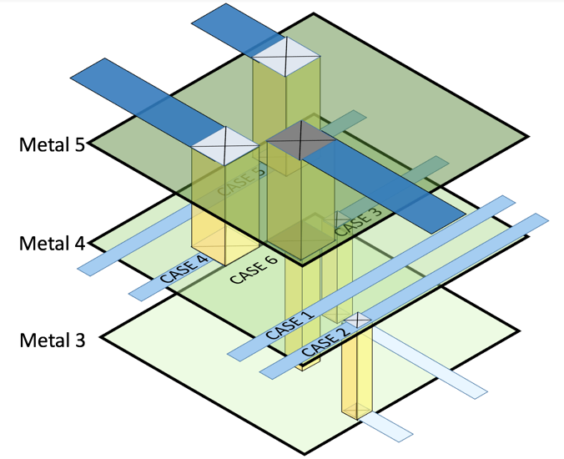
Summary of Preliminary Exam
Via size-aware global routing
Models to capture the impact of via size on routing resource usage during GR
Via size-aware layer assignment algorithm for GR

Slide 14
TraPL: Via-aware Track Planning for GR

Slide 15
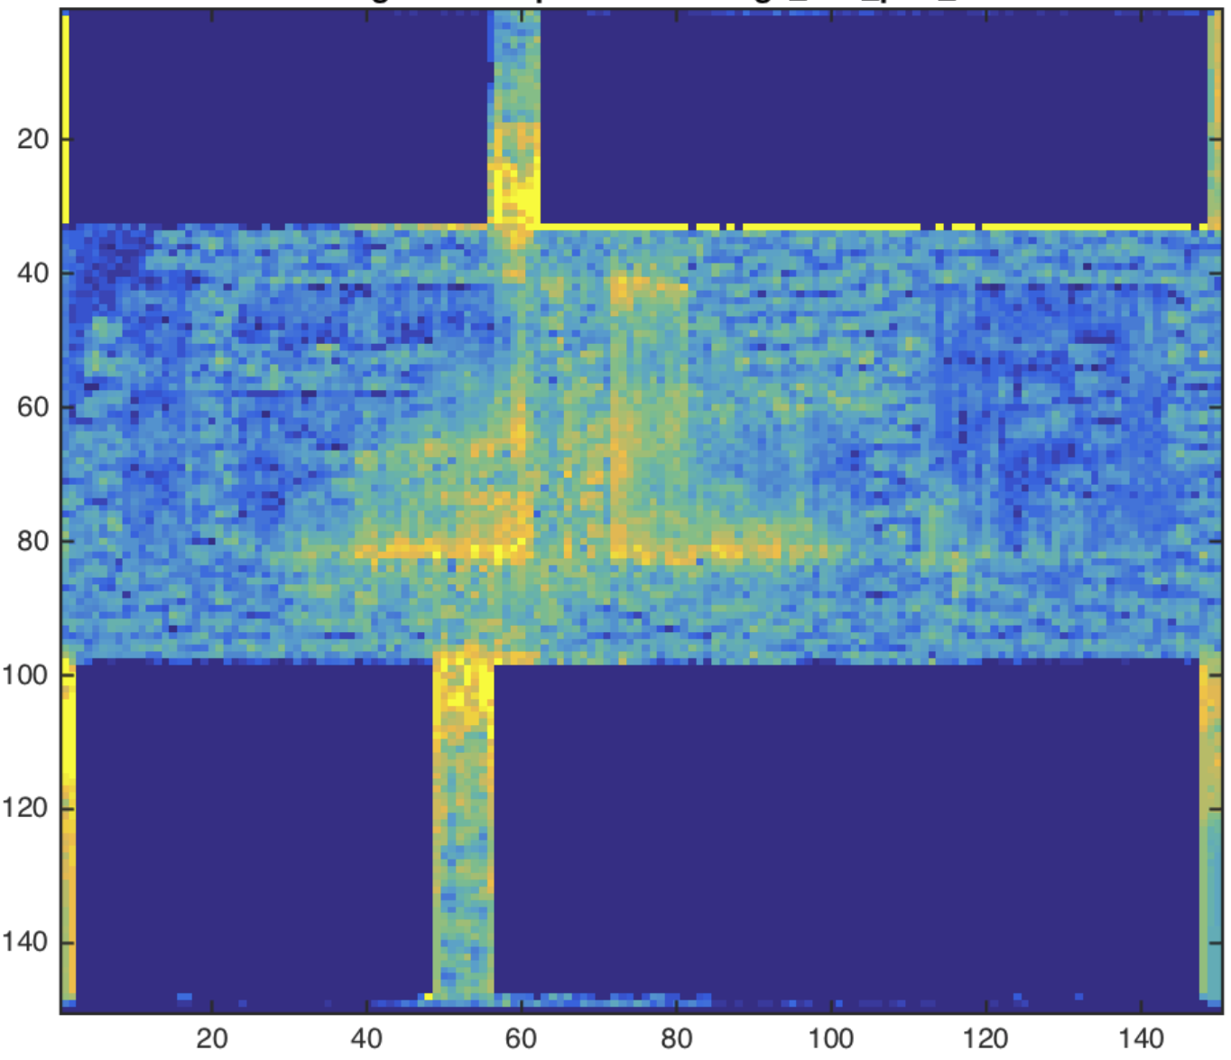
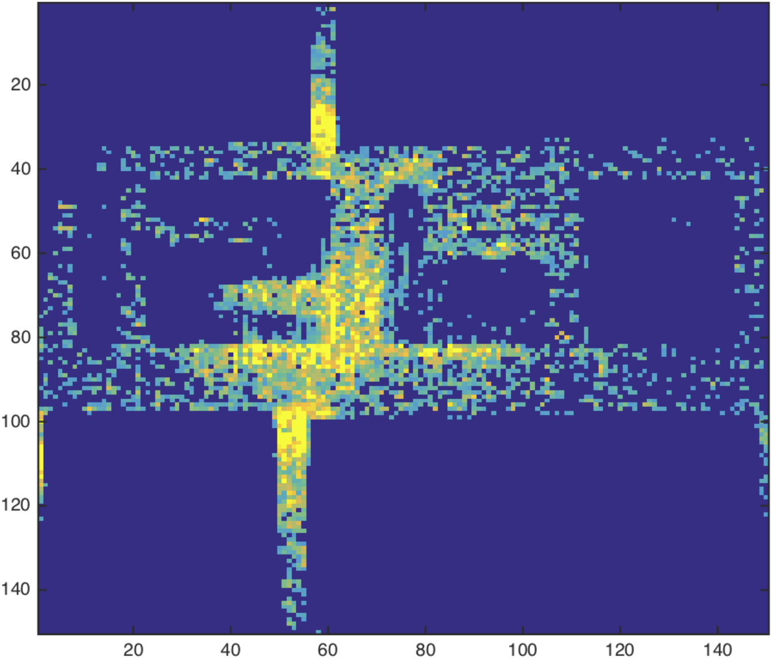
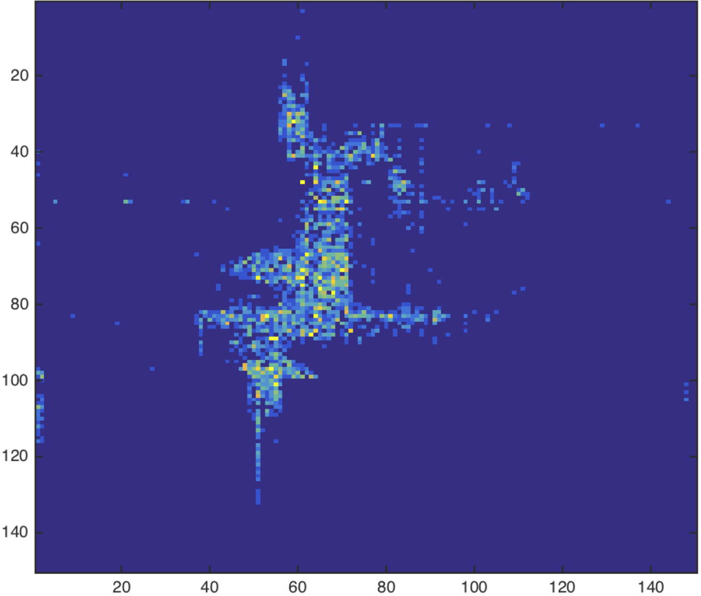
Our Proposed Analyzer
Olympus-GR
Runtime: 10s
Our analyzer
Runtime: 50s
Olympus-DR
Runtime: 3000s
Provides better estimation of local congestion for GR
Integrated with Olympus tool by Mentor Graphics
Evaluated using industry benchmarks released in the ISPD 2015 contest
Example design shown above:
45nm technology; GR grid-size: 150x150 for 5 metal layers
# cells = 108,288 and # nets = 110,281

Slide 16
Motivation for Via Awareness
Impact of via-awareness during track assignment on local congestion in g-cells
Routing segment on M4
Inter-layer via between M3 and M4
Routing segment on M3
Net B
Net A
Routing segment on M3
…
Inter-layer via between M3 and M4
g-cell on M3
Routing segment on M4
Net A and Net B are routed on different tracks in the g-cell.

Slide 17
Motivation for Via Awareness
Impact of via-awareness during track assignment on local congestion in g-cells
Net A
Net B
…
g-cell on M3
Net A and Net B are routed on the same track in the g-cell.
These two routed segments don’t cause overlap.

Slide 18
Motivation for Via Awareness
Impact of via-awareness during track assignment on local congestion in g-cells
Track overlap
Net A
Net B
…
g-cell on M3
Net A and Net B are routed on the same track in the g-cell.
These two routed segments cause overlap.

Slide 19
Features of Our Analyzer
Our analyzer can be used in two ways
ViA: Via analyzer
A variation of our framework which takes as input an existing track assignment solution and determines the locations of all vias inside the g-cells for better estimation of track overlap
Considers two cases of stacked and unstacked vias
We show ViA can improve the accuracy of predicting local congestion inside the g-cells for two competitive track assignment techniques
TraPL: Track Planning with Local congestion
A framework takes as input an existing GR solution and generates a track assignment while considering via locations to minimize the total overlap on the tracks
We show TraPL has better accuracy for predicting local congestion inside the g-cells compared to other techniques

Slide 20
Via Analyzer: Unstacked Vias
Two assigned segments are located on adjacent layers
e.g., segment on M3 assigned to track t1 and segment on next layer (M4) assigned to track t2 connect to each other
The via location lies on the intersection area of the two tracks
This is assuming that in practice routing is uni-directional on each layer and that the direction alternates every layer
After finding the via location, we can compute partial utilization on the tracks
M4
…
t1
M3
…

Slide 21
Via Analyzer: Stacked Vias
Two assigned segments are apart by more than one layer
Consider adding a local wire for the layer in between
e.g., a local wire is added on track t2 on M4 between M3 and M5
Determine a track for the local wire
Among all track options, pick the one with minimum overlap with other assigned segments
t28
M5
…
30 tracks
M4
t2
…
M3
t1
…

Slide 22
Features of Our Analyzer
Our analyzer can be used in two ways
ViA: Via analyzer
A variation of our framework which takes as input an existing track assignment solution and determines the locations of all vias inside the g-cells for better estimation of track overlap
Considers two cases of stacked and unstacked vias
We show ViA can improve the accuracy of predicting local congestion inside the g-cells for two competitive track assignment techniques
TraPL: Track Planning with Local congestion
A framework takes as input an existing GR solution and generates a track assignment while considering via locations to minimize the total overlap on the tracks
We show TraPL has better accuracy for predicting local congestion inside the g-cells compared to other techniques

Slide 23
A Popular Track Assignment Technique
GR solution
RR (Regular Route) [1]
Process all the segments greedily to minimize the number of track overlaps
Route local nets
Panel ordering
Finish all panels?
Move to the next panel and sort all its segments by length in descending order
No
Yes
Track Assignment
solution
Y. Zhang et al. “Regular Route: An efficient detailed router applying regular routing patterns”, TVLSI, 2013.

Slide 24
Track Assignment with RR: Example

Slide 25
Our Track Assignment Technique
GR solution
RR (Regular Route)
TraPL
Process all the segments greedily to minimize the number of track overlaps
Process all the nets overlapping the current panel to minimize the amount of track overlaps with via awareness
Route local nets
Panel ordering
Finish all panels?
Move to the next panel and sort all its segments by length in descending order
No
Yes
Track Assignment
solution

Slide 26
Track Assignment with TraPL: Example

Slide 27
Track Assignment for A Single Net
Input
Global segments of one net
Output
Assignment of a track for each global segment of the net
High-level procedure:
Construct a weighted graph
Captures all track assignment possibilities for the segments of the net
Edge weights reflect degree of overlap with already-processed nets
Determine the best track assignment by solving min-cost path corresponding to the the two pins of the net

Slide 28
Track Assignment for A Single Net
segment 1
segment 2
segment 3
SRC
DST
DST edges
SRC edges
Segment edges
Via edges
segment in M2
global segments of a two-pin net
segment 2 in M3
segment 1 in M2

Slide 29
Track Assignment for A Single Net
SRC
DST
global segments of a two-pin net

Slide 30
Track Assignment for A Single Net
Weights are defined for edges corresponding to segments and vias
Weight of an edge reflects amount of change in a “track overlap” metric in the g-cells corresponding to the segments/via represented by the edge
With the above definition of weights, solving the min-cost path problem from SRC to DST creates the “best” track assignment solution
The best solution results in minimum total track overlap for all the processed nets

Slide 31
Track Assignment for A Single Net
Example to compute the edge weights
SRC
…
This segment (in light blue):
contributes 0 to SRC edge
contributes 0 to segment edge
contributes 0 to via edges
This segment (in yellow):
contributes 8 to SRC edge
contributes 3 to segment edge
contributes 0 to via edges
This segment (in pink):
contributes 0 to SRC edge
contributes 0 to segment edge
contributes 4 to via edges
8
3
10
4

Slide 32
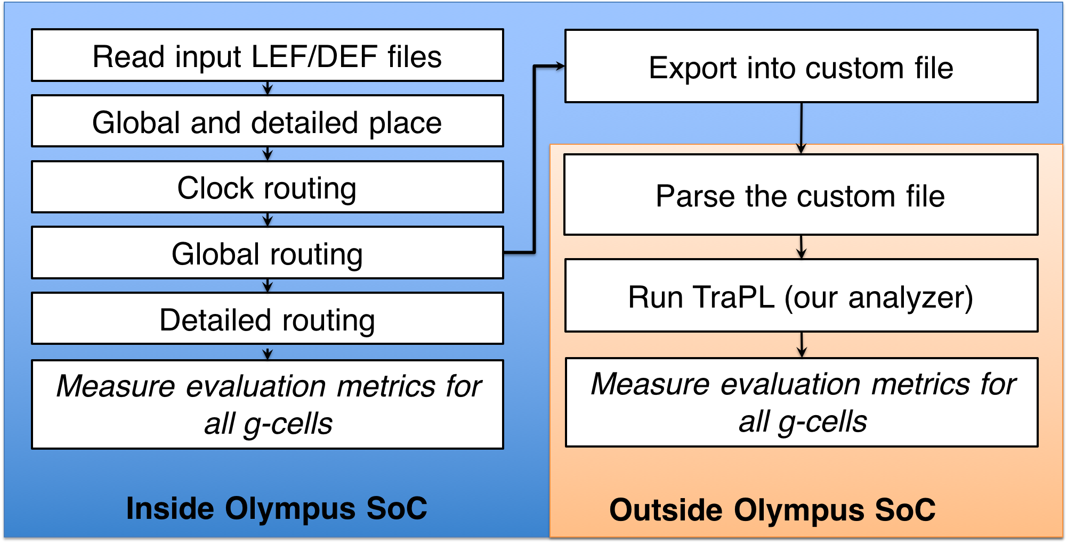
Evaluation Platform and Benchmarks
Built a platform using Olympus tool of Mentor Graphics
Wrote Tcl scripts to connect our C++ code with Olympus
Measured metrics reflecting prediction accuracy of local congestion inside the g-cells for different approaches with respect to Olympus-DR as reference

Slide 33
Comparison with Other Techniques
Implemented the following assignment techniques
RR [1]
Performs track assignment on panel-by-panel basis by reducing number of overlapped segments
NTA [2]
Extension of RR which further reduces overlap by reassigning segments to tracks of each panel using rip-up and reroute strategy
Minimizes track overlap assuming all vias are at the center of g-cells
Two variations of our framework were implemented:
TraPL: Track Planning of Local congestion for global routing:
ViA: Via Analyzer
Y. Zhang et al. “RegularRoute: An efficient detailed router applying regular routing patterns”, TVLSI 2013.
M. Wong et al. “Negotiation-based track assignment considering local nets”, ASPDAC 2016

Slide 34
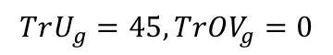
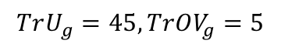
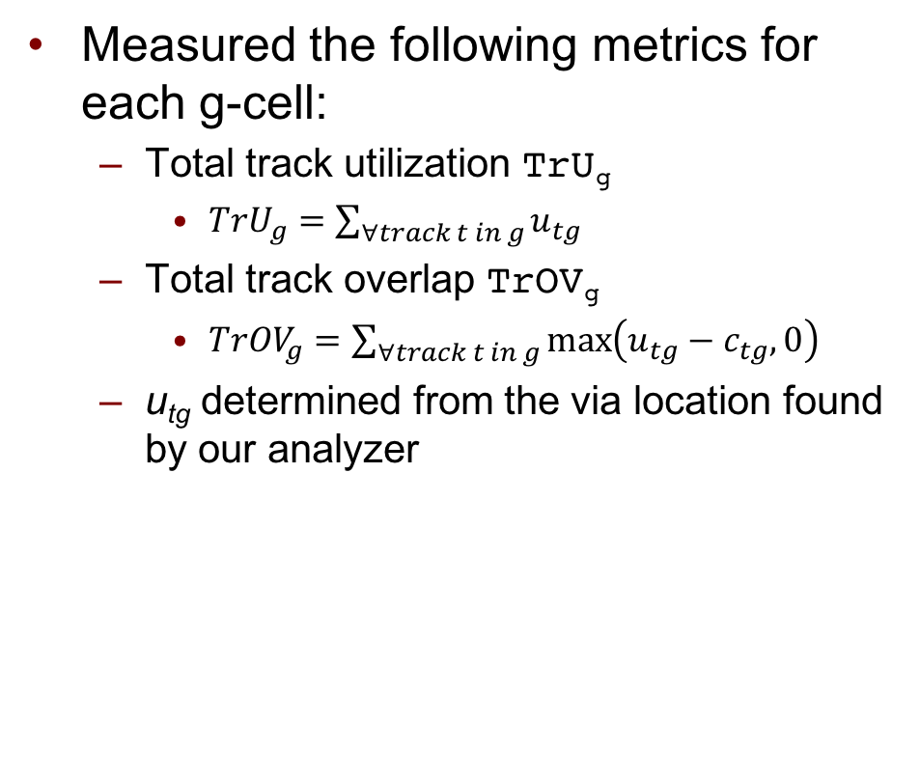
Measured Metrics
Measured the following metrics for each g-cell:
Total track utilization TrU_{g}
$TrU_{g}=\sum_{∀track t in g}{u_{tg}}$
Total track overlap TrOV_{g}
$TrOV_{g}=\sum_{∀track t in g}{\max\left(u_{tg}−c_{tg},0\right)}$
u_{tg} determined from the via location found by our analyzer
20
25
…
track capacity =40
$$TrU_{g}=45, TrOV_{g}=0$$
25
20
…
track capacity =40
$$TrU_{g}=45, TrOV_{g}=5$$

Slide 35
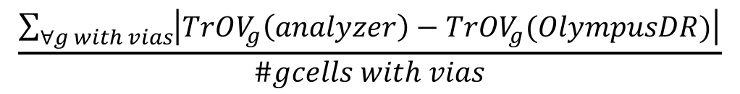
Simulation Results
Comparison of mismatch error in track overlap TrOV_{g}
$$\frac{\sum_{∀g with vias}{\left|TrOV_{g}\left(analyzer\right)−TrOV_{g}(OlympusDR)\right|}}{\#gcells with vias}$$
BENCHMARK | RR | NTA | TraPL | %gcells
mgc_des_perf_1 | 19.0% | 14.2% | 9.4% | 98.5%
mgc_des_perf_a | 8.6% | 6.8% | 5.5% | 46.0%
mgc_des_perf_b | 7.1% | 5.8% | 5.2% | 92.0%
mgc_edit_dist_a | 18.6% | 13.6% | 10.4% | 71.0%
mgc_fft_1 | 15.1% | 11.1% | 9.0% | 99.7%
mgc_fft_2 | 9.6% | 6.9% | 6.9% | 78.9%
mgc_fft_a | 8.4% | 6.8% | 7.3% | 34.1%
mgc_fft_b | 7.9% | 6.3% | 6.9% | 31.9%
mgc_matrix_mult_1 | 18.6% | 13.8% | 9.3% | 99.9%
mgc_matrix_mult_a | 8.0% | 6.4% | 5.7% | 25.0%
mgc_matrix_mult_b | 5.7% | 4.7% | 4.8% | 30.3%
mgc_pci_bridge32_a | 5.9% | 4.7% | 4.7% | 69.1%
mgc_pci_bridge32_b | 2.4% | 2.1% | 2.3% | 34.7%
AVERAGE | 10.4% | 7.9% | 6.7% | 62.4%
Error in TrOV_{g} for RR and NTA
Error in TrOV_{g} for TraPL
Percent of gcells containing vias
Our analyzer TraPL results in the smallest mismatch in TrOV_{g} with respect to Olympus-DR

Slide 36
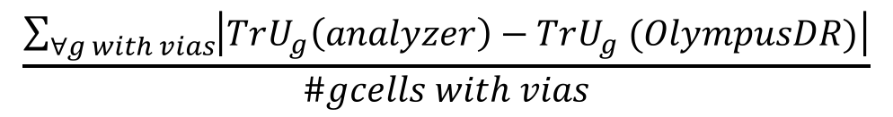
Simulation Results
Comparison of mismatch error in track utilization TrU_{g}
$$\frac{\sum_{∀g with vias}{\left|TrU_{g}\left(analyzer\right)−TrU_{g} (OlympusDR)\right|}}{\#gcells with vias}$$
BENCHMARK | Olympus-GR | RR/NTA | RR+ViA | NTA+ViA | OURS
mgc_des_perf_1 | 20.71% | 21.35% | 18.43% | 17.73% | 11.52%
mgc_des_perf_a | 11.37% | 11.36% | 10.03% | 11.29% | 8.27%
mgc_des_perf_b | 11.66% | 11.99% | 10.41% | 12.05% | 8.06%
mgc_edit_dist_a | 15.10% | 15.88% | 13.96% | 14.74% | 11.93%
mgc_fft_1 | 18.42% | 19.37% | 16.96% | 16.10% | 12.68%
mgc_fft_2 | 13.19% | 14.53% | 13.52% | 14.88% | 9.29%
mgc_fft_a | 11.98% | 11.56% | 11.15% | 10.06% | 10.86%
mgc_fft_b | 10.12% | 9.76% | 9.32% | 9.30% | 10.65%
mgc_matrix_mult_1 | 19.00% | 19.96% | 17.59% | 17.71% | 11.18%
mgc_matrix_mult_a | 11.27% | 11.10% | 9.87% | 10.48% | 7.89%
mgc_matrix_mult_b | 8.67% | 8.59% | 7.93% | 9.51% | 7.43%
mgc_pci_bridge32_a | 11.25% | 9.76% | 8.86% | 9.86% | 7.56%
mgc_pci_bridge32_b | 6.75% | 5.53% | 5.23% | 6.43% | 5.43%
AVERAGE | 13.04% | 13.13% | 11.79% | 12.32% | 9.44%
Error in TrU_{g}
Olympus-GR: considers only the track utilization of global routes
RR/NTA: also considers the track utilization of local nets
Error in TrU_{g}
RR+ViA and NTA+ViA: ViA analyzes the track assignment solution generated by NTA or RR
Error in TrU_{g} for our analyzer TraPL
Our analyzer TraPL results in the smallest mismatch in TrU_{g} with respect to Olympus-DR

Slide 37
Simulation Results
Comparison of runtimes (in seconds)
BENCHMARK | RR | NTA | TraPL | Olympus-DR
mgc_des_perf_1 | 0.3 | 3.3 | 46.1 | 7200
mgc_des_perf_a | 0.4 | 11.6 | 55.9 | 3000
mgc_des_perf_b | 0.3 | 5.2 | 48.4 | 1800
mgc_edit_dist_a | 0.8 | 20.0 | 115.4 | 14400
mgc_fft_1 | 0.1 | 1.1 | 11.6 | 2400
mgc_fft_2 | 0.1 | 1.8 | 10.2 | 1200
mgc_fft_a | 0.2 | 12.0 | 16.1 | 1500
mgc_fft_b | 0.2 | 4.7 | 17.7 | 1200
mgc_matrix_mult_1 | 0.5 | 12.0 | 65.1 | 10800
mgc_matrix_mult_a | 0.6 | 29.3 | 68.5 | 1800
mgc_matrix_mult_b | 0.7 | 24.4 | 73.6 | 1800
mgc_pci_bridge32_a | 0.1 | 1.5 | 9.1 | 240
mgc_pci_bridge32_b | 0.1 | 2.1 | 9.7 | 120
AVERAGE | 0.33 | 9.92 | 42.11 | 3650

Slide 38
Conclusions of Our Experiments
Showed the integration of our proposed via location model and track assignment can reduce the mismatch error
Showed as a ViA analyzer, we can improve the mismatch error for other track assignment techniques
Showed improvement in mismatch error between GR and DR for both track utilization and track overlap

Slide 39
Summary of the Dissertation
To reduce the gap between GR and DR:
Studied the impact of varying-sized vias
Studied the impact of via locations inside g-cells
Studied techniques to improve pin accessibility for GR using “3DM technology”
Proposed new metrics for evaluation and optimization of routability for GR

Slide 40


Slide 41
BACK-UP SLIDES
Complementary materials for other projects

Slide 42
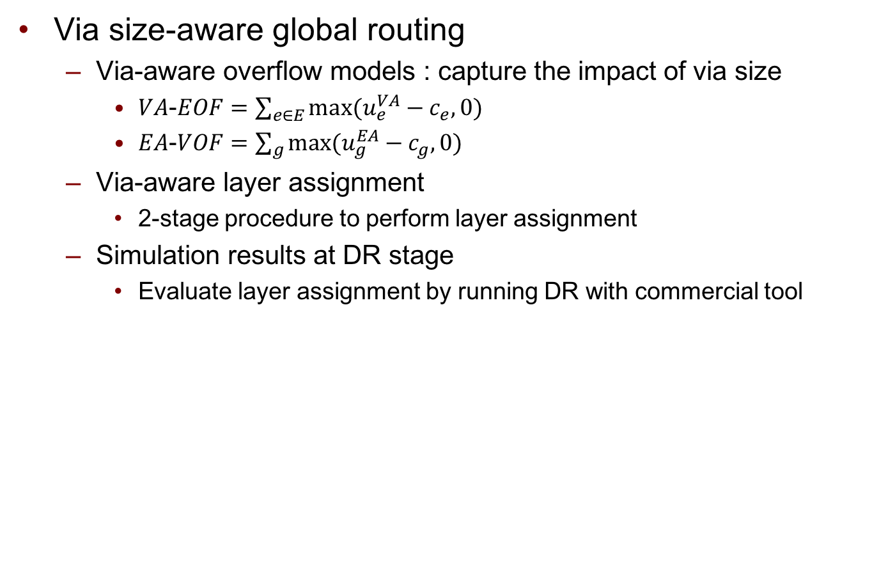
1) Via Size-Aware Global Routing
Via size-aware global routing
Via-aware overflow models : capture the impact of via size
$VA$-$EOF=\sum_{e∈E}{max⁡(u_{e}^{VA}−c_{e},0)}$
$EA$-$VOF=\sum_{g}{max⁡(u_{g}^{EA}−c_{g},0)}$
Via-aware layer assignment
2-stage procedure to perform layer assignment
Simulation results at DR stage
Evaluate layer assignment by running DR with commercial tool
Case ID | r_{te} | a_{tg}
1 | L&R: (w_{t}+s_{t}) | (w_{t}+s_{t}) x W
2 | L&R: (w_{t}+s_{t}) | (w_{t}+s_{t}) x W
3 | R: (w_{t}+s_{t}) | (w_{t}+s_{t}) x W / 2
4 | L: (w_{v}+s_{v}) | (w_{t}+s_{t}) x W / 2
5 | L&R: (w_{v}+s_{v}) | (w_{v}+s_{v})x W
6 | - | (w_{v}+s_{v})²

Slide 43
1) Via Size-Aware Global Routing
Via size-aware layer assignment
Stage 1 : dynamic programming (DP) for one net
Example :
For edge (v1, p1), three sub-problems are considered :
f(v1, 2), f(v1, 4) and f(v1, 6)
Assume the cost function only depends on via count
For f(v1,6) we need 5 vias to connect (p1,v1) to p1 on M1
Similarly we update the cost function to calculate VAEOF and EAVOF
M6
Via56
Via45
p1
v1
M4
Via34
v2
p2
Via23
M2
Via12
M1
p1
v1

Slide 44
1) Via Size-Aware Global Routing
Via size-aware layer assignment
Example of LP for one edge set
vias
edge
edge set
Take the 3-D routing solution of DP as input
Before LP, it requires 4 vias to make the part of nets within the edge set connected to the other parts outside the edge set.
net1
M5
net2
M4
Change the routes within the edge set during LP while keeping the edge utilizations within the edge set unchanged.
M3
After LP, it requires only 2 vias to make the part of nets within the edge set connected to the other parts outside the edge set.
Notes:
Here is the example of how the LP operates on one edge set to minimize the via count.
This is an edge set because they all have the same 2-D projection.(CLICKx2)
// Click and read
We keep the routes fixed in neighboring edge sets when we are solving LP for one edge set.
Then we re-arrange the routes within the edge set to further minimize the number of vias while keeping the edge utilizations within the edge set unchanged.
After the LP finishes for this edge set,
only 2 vias are required to make net1 and net2 connected,
while the edge utilization doesn't change.
There is one and only one wire routed on the edges on M4 and M5 before and after LP.
We have a LP to minimize the via count.
It solves edge set by edge set.
It doesn’t ensure that our proposed metrics don’t change.
But we force some constraints that the traditional edge utilization doesn’t change after LP is solved.

Slide 45
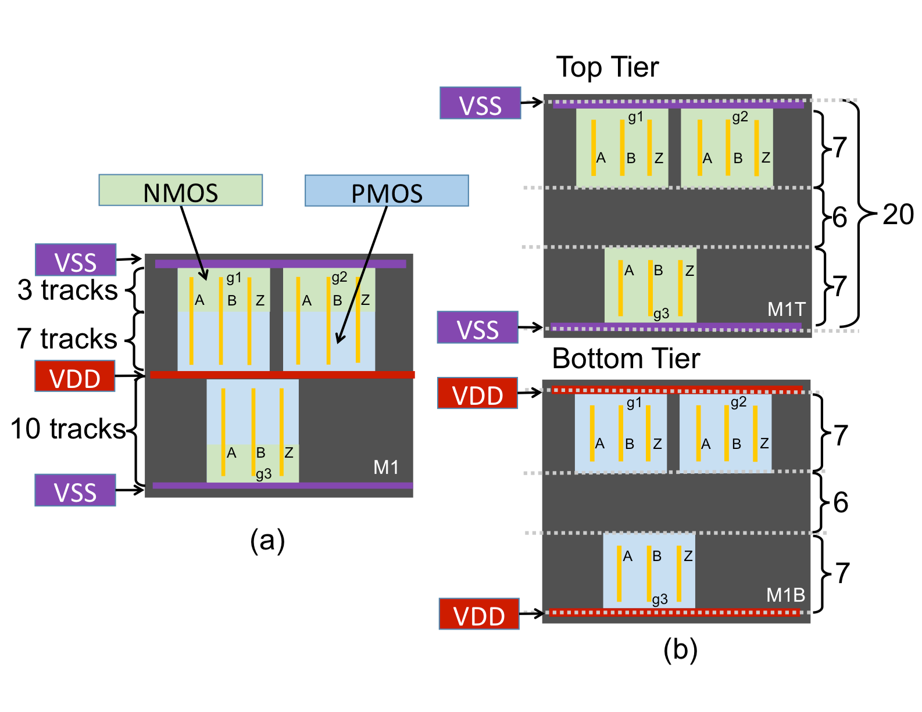
3) Improving pin access with 3DM

Slide 46
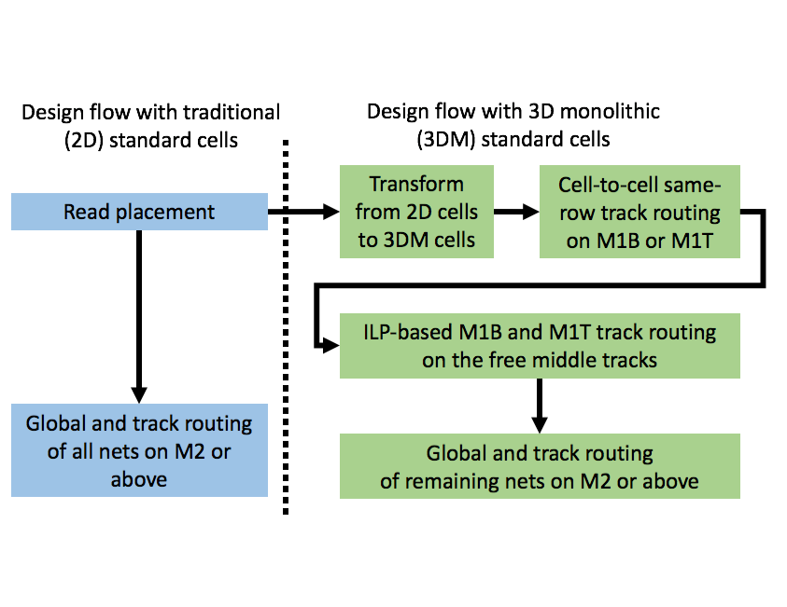
3) Improving pin access with 3DM

Slide 47
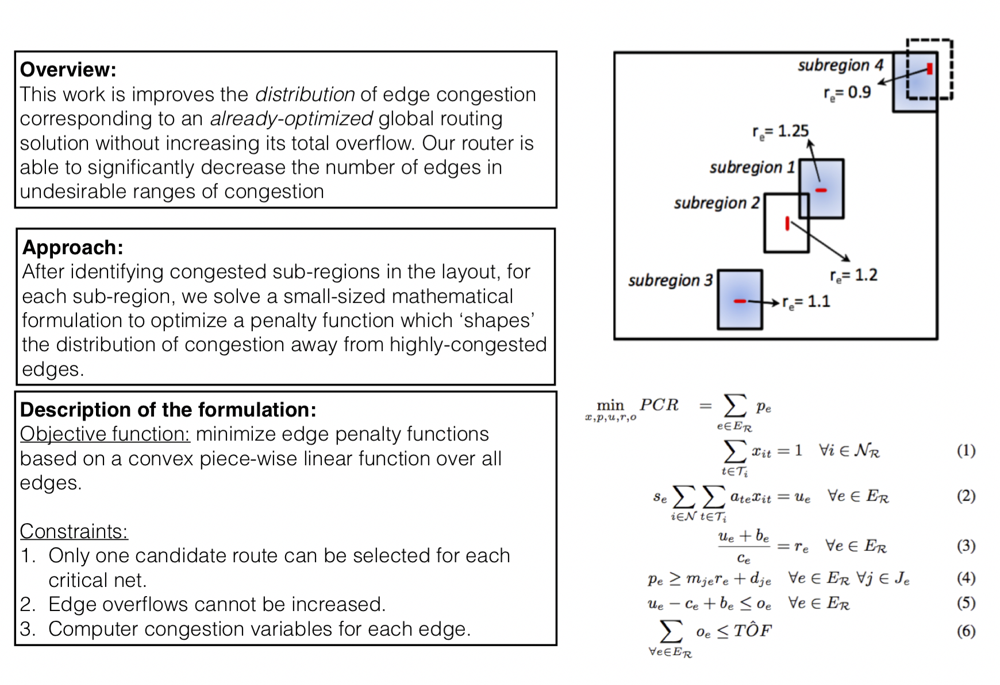
4) Evaluation and Optimization of Routability for GR

Slide 48
back-up slides not showing in print-out

Slide 49
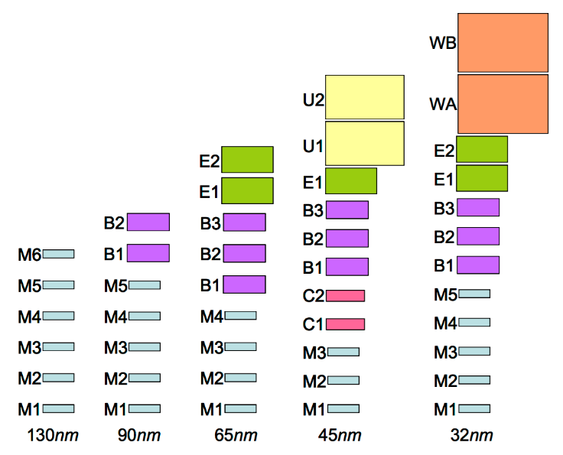
Introduction and Preliminaries
Sources of mismatch between GR and DR
Inter-layer vias [1-4]
Connecting adjacent metal layers of different wire sizes requires using a large via relative to the metal layer with the smaller wire size
Via blocks routing tracks in the metal layer with smaller wire size
Certain types of nets such as the ones on the timing-critical paths require more spacing with wire segments of adjacent nets
X. Jia et al. “MCFRoute: a detailed router based on multi-commodity flow method”, ICCAD, 2014.
K. Han et al. “Evaluation of BEOL design rule impacts using an optimal ILP-based detailed router”, DAC, 2015.
Y. Zhang et al. “RegularRoute: an efficient detailed router with regular routing patterns”, ISPD, 2011.
C. Hsu et al. “Multi-layer global routing considering via and wire capacities”, ICCAD, 2008.
Notes:
Another mismatch I'm going to discuss is about via restrictions and spacing issues.
First lets talk about via restriction.
For example, in this metal layer, there are two routes with different kinds of via connection.
These two are vias. They are used to connect two adjacent metal layers to each other.
One route is connected to the lower metal layer thru a via.
The via size is the same with the wire size on that metal layer.
The other route is connected to the higher metal layer thru a larger via.
This via is larger than the other one because the higher metal layer has a greater wire size.
So a larger via is required to connect two adjacent metal layers of different wire sizes.
Compared to the other one, the large via may cause more blockage, which has never been considered before in any other work.
However, such issue is becoming more common, especially in advanced tech nodes.
For example, metal layers with four different wire sizes are used in 32 nm.
The wire sizes in two adjacent metal layers can differ up to 2x.
Second, let's talk about spacing issues.
Certain types of nets may require more spacing with wire segments of adjacent nets, especially on timing-critical paths.

Slide 50
Summary of Preliminary Exam
Via size-aware global routing
Via-aware overflow models : capture the impact of via size
$VA$-$EOF=\sum_{e∈E}{max⁡(u_{e}^{VA}−c_{e},0)}$
$EA$-$VOF=\sum_{g}{max⁡(u_{g}^{EA}−c_{g},0)}$
Via-aware layer assignment
2-stage procedure to perform layer assignment
Simulation results at DR stage
Evaluate layer assignment by running DR with commercial tool
Case ID | r_{te} | a_{tg}
1 | L&R: (w_{t}+s_{t}) | (w_{t}+s_{t}) x W
2 | L&R: (w_{t}+s_{t}) | (w_{t}+s_{t}) x W
3 | R: (w_{t}+s_{t}) | (w_{t}+s_{t}) x W / 2
4 | L: (w_{v}+s_{v}) | (w_{t}+s_{t}) x W / 2
5 | L&R: (w_{v}+s_{v}) | (w_{v}+s_{v})x W
6 | - | (w_{v}+s_{v})²

Slide 51
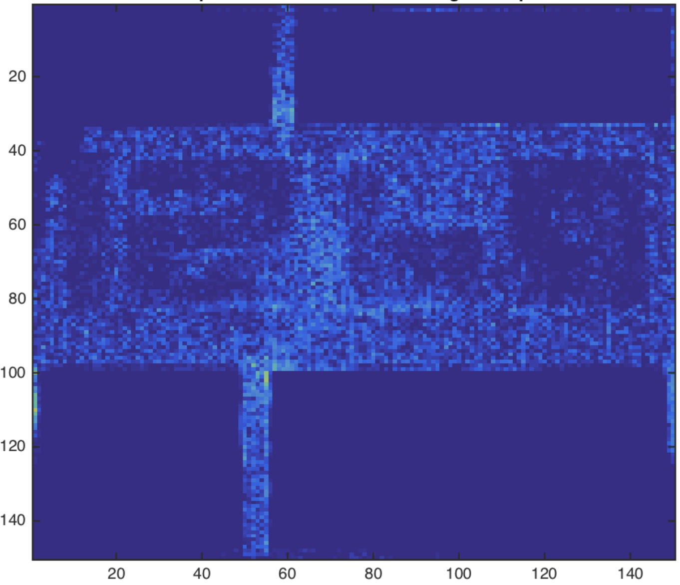
Track planning of local congestion
Olympus-DR
Olympus-GR
Track planning
w\o consideration of via location
Track planning
w\ consideration of via location

Slide 52
Via Analyzer: Stacked Vias
Two assigned segments are apart by more than one layer
Evaluate all track options in the g-cell(s) in between and select the one with minimum overlap with other assigned segments
t28
M5
u_{tg} = 28 x pitch_size
…
30 tracks
t2
M4
u_{tg} = 28 x pitch_size
…
t1
M3
u_{tg} = 3 x pitch_size
…

Slide 53
Track assignment for one panel
Sort all the global segments on p by length
Call DRoute(gnet(s)) to perform track routing for gnet(s)
let gnet(s) be the global net containing s
No
mark gnet(s) ‘processed’
gnet(s) is processed?
No
Finish all segments?
Yes
Track assignment for panel p
Yes
END

Slide 54
Implemented technique : RR
GR solution
Move to next panel & process all segments overlapping it
Route local nets
Greedily assign tracks by solving MWIS problem
Panel ordering
No
Finish all panels?
Yes
Compute track overlap for each g-cell
RR

Slide 55
Implemented technique : NTA
GR solution
Move to next panel & process all segments overlapping it
Initial track assignment
Route local nets
Reduce track overlap by rip-up and re-assign
Panel ordering
No
Finish all panels?
Yes
Compute track overlap for each g-cell
NTA

Slide 56
Implemented technique : ours
GR solution
Our analyzer : track planning (TraPL)
Move to next panel & process all nets overlapping it
Route local nets
Solve DR for this net with graph model
Panel ordering
No
Finish all panels?
Yes
Compute track overlap for each g-cell
Ours

Slide 57
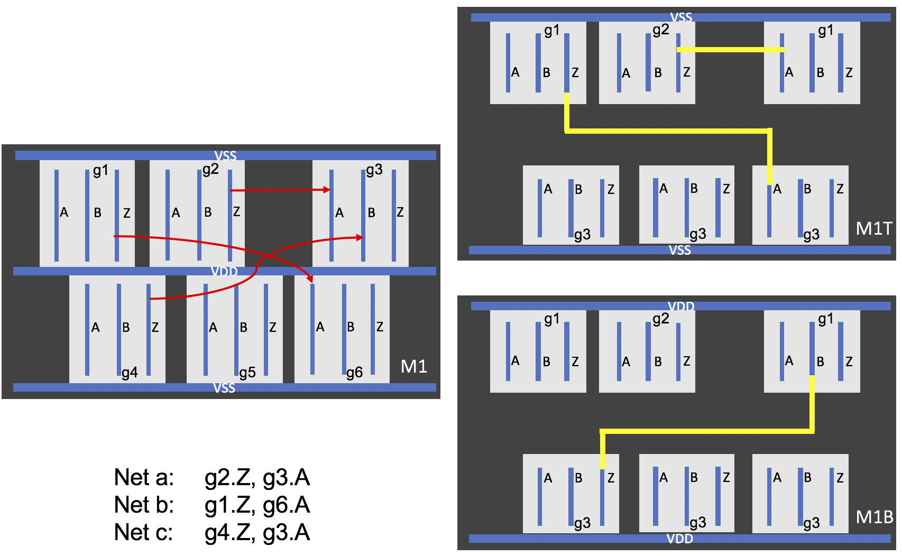
Improving pin access with 3DM SC

Slide 58
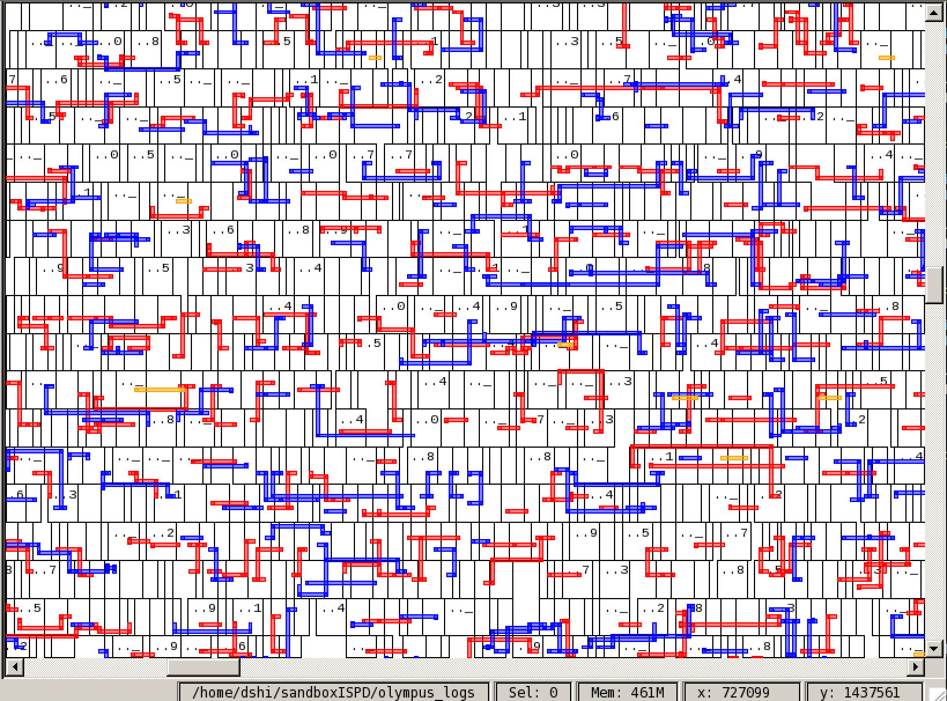
Improving pin access with 3DM SC

